Slide 1
System Boot and Init Process
20XW51 - Unix Architecture and Programming
20pw16

Slide 2
Bootstrap
Loading a copy of the OS into the main memory for execution.
On UNIX systems, the bootstrap procedure eventually reads the boot block (block 0) of a disk, and loads it into memory.
The program contained in the boot block loads the kernel from the file system

Slide 3
Kernel
After the kernel is loaded in memory, the boot program transfers control to the start address of the kernel, and the kernel starts running (algorithm start).
The kernel initializes its internal data structures.
After completing the initialization phase, it mounts the root file system onto root ("/") and fashions the environment for process 0, creating a u area, initializing slot 0 in the process table and making root the current directory of process 0, among other things.

Slide 4
In addition to the text, data, and stack segments, the operating system also maintains for each process a region called the u area (user area). The u area contains information specific to the process (e.g., open files, current directory, signal actions, accounting information) and a system stack segment for process use.
When the environment of process 0 is set up, the system is running as process 0. Process 0 forks,
The new process, process 1, running in kernel mode, creates its user-level context by allocating a data region and attaching it to its address space.
Process 1 is a user-level process. as opposed to process 0, which is a kernel-level process that executes in kernel mode. The text for process 1, copied from the kernel, consists of a call to the exec system call to execute the program "/etc/init". Process 1 calls exec and executes the program in the normal fashion. Process 1 is commonly called init because it is responsible for initialization of new processes

Slide 5
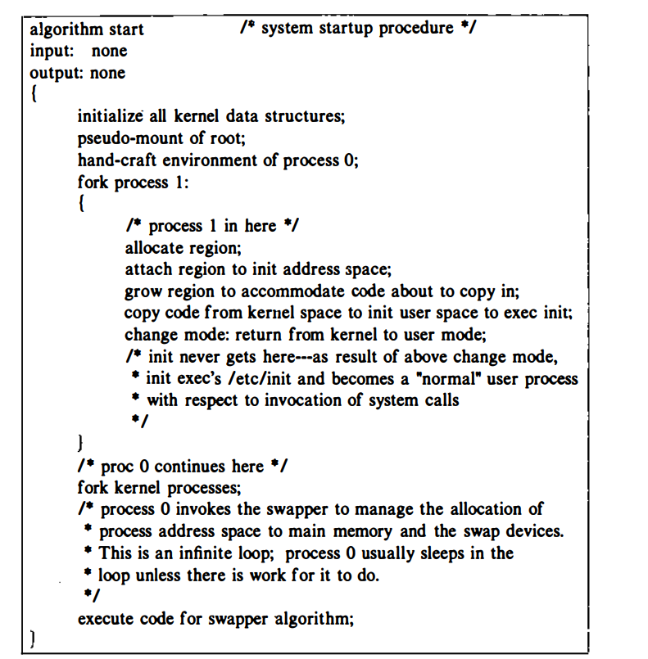

Slide 6

Init Process
The init process is a process dispatcher, spawning processes that allow users to log in to the system, among others. /nit reads the file "/etc/inittab" for instructions about which processes to spawn. The file "/etc/inittab" contains lines that contain an "id," a state identifier (single user, multi-user, etc.), an "action" , and a program specification .
init reads the file and, if the state in which it was invoked matches the state identifier of a line, creates a process that executes the given program specification.
Meanwhile, init executes the wait system call, monitoring the death of its child processes and the death of processes "orphaned" by exiting parents.

Slide 7
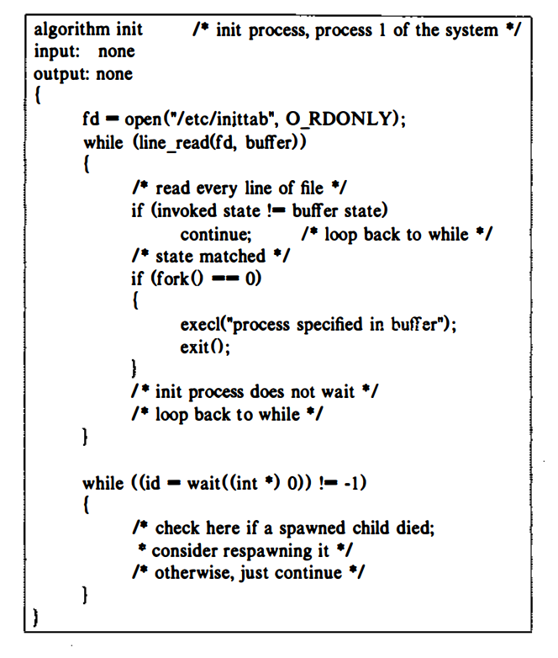

Slide 8
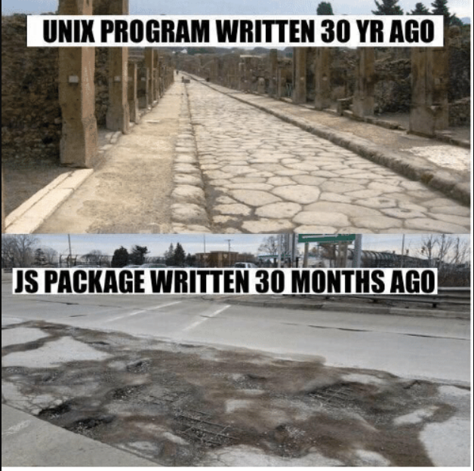
Thank You

